Slide 1
Jillian Ireland
Data Science Challenge for Insulet
Visualization tool: R
November 11, 2020

Slide 2
OUTLINE
Qgg and yyz have normal distributions centered at zero.
Foo, wsg, hrt have normal distributions not centered at zero.
All other variables did not have normal distributions.
Fyt and lux may have an inverse relationship.
An event in 2019 led to less data points by class for several variables.
High level of correlation was detected between juu and wsg.
Qgg, yyz, and gox have similar relationships to target.
Sinusoidal relationship between target and date.

Slide 3
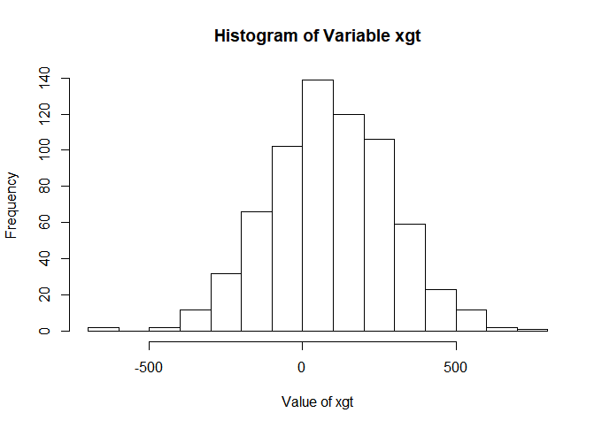
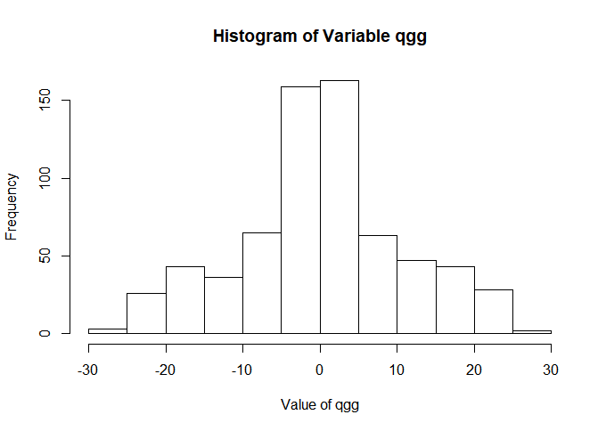
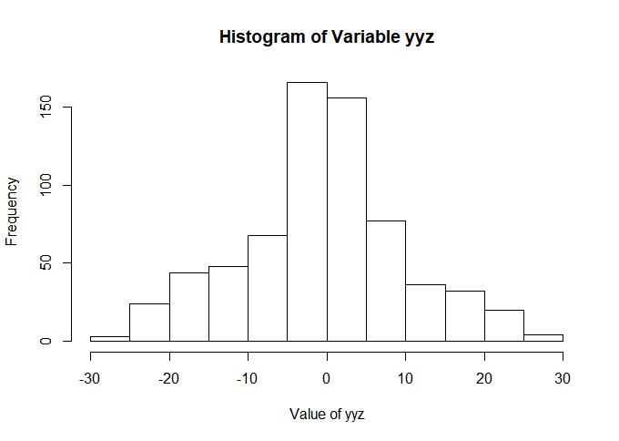
Variables with Normal Distributions Centered at Zero
Qgg and yyz are not only centered around zero but have very similar distributions ranging from -30 to 30 with a frequency of 150.

Slide 4
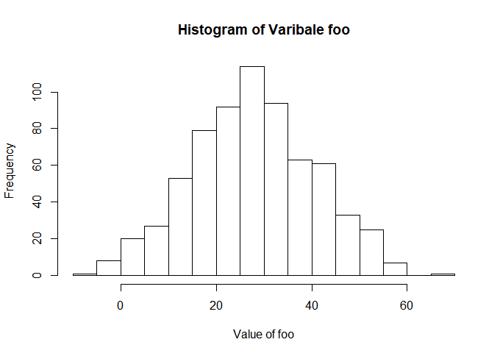
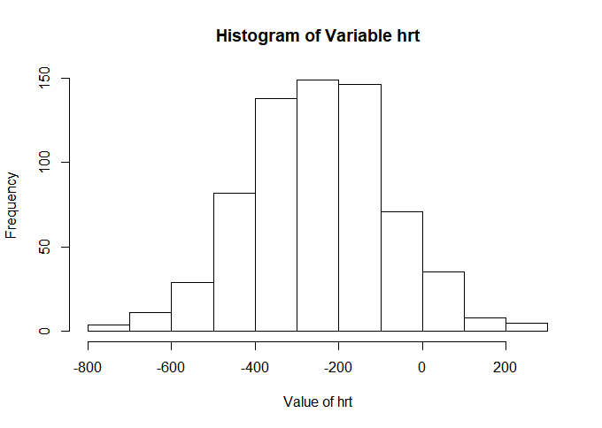
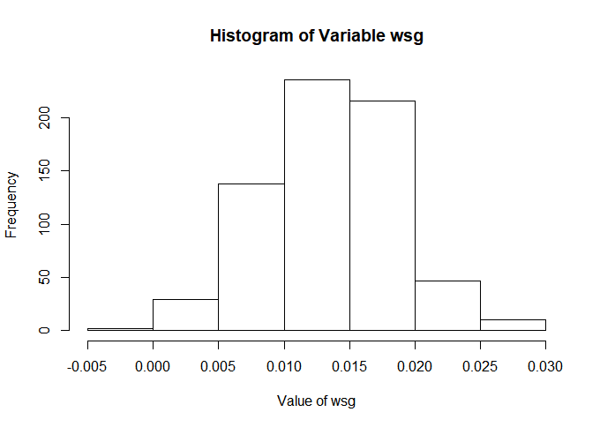
Normally distributed Variables
Foo, wsg, and hrt all follow normal distributions and may need some level of normalization before any kind of modeling can occur.
All other numerical variables do not follow a normal distribution.

Slide 5
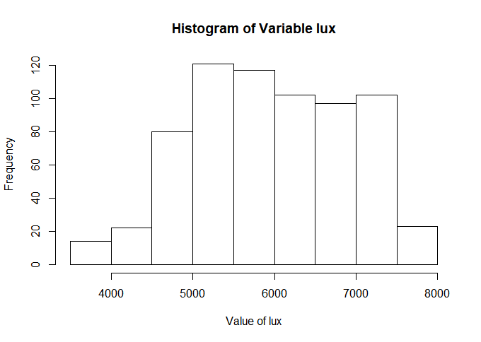
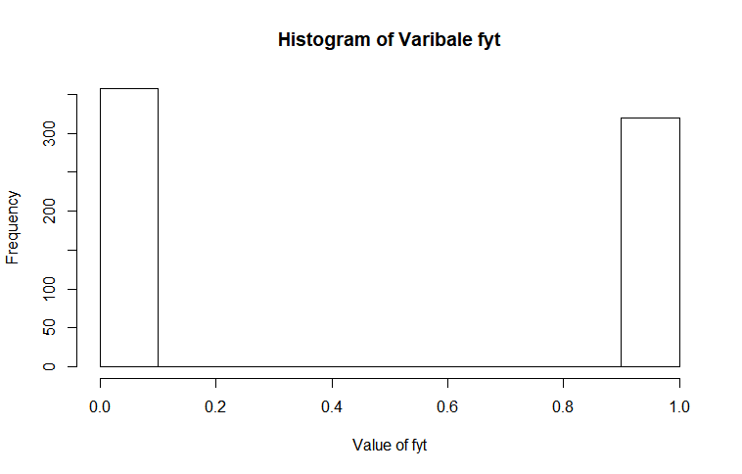
Potentially an Inverse Relationship Between fyt and lux
Important to note that fyt is a binary variable this may be a categorical dependency (i.e. overweight or not overweight leads to higher rates of heart disease)

Slide 6
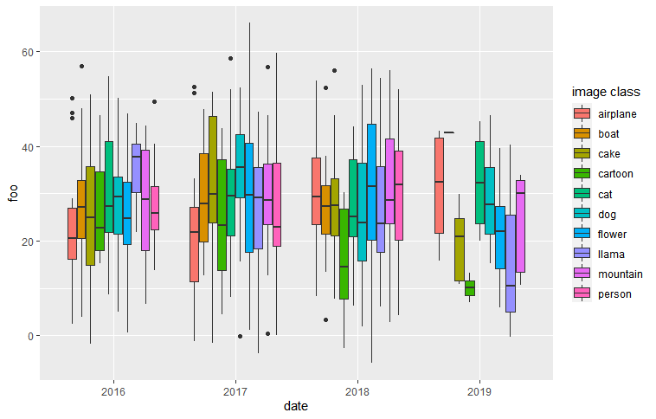
Data with Minimal Outliers
Box Plot Of foo Grouped By Image Class And Year
The distributions for 2019 vary from previous years, making it important to account for the event that triggered this outcome. The boat, cartoon, and flower class were all impacted. The person class entirely disappeared.

Slide 7
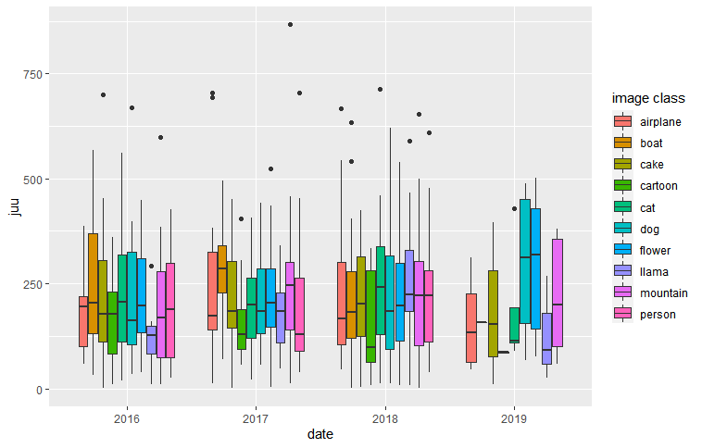
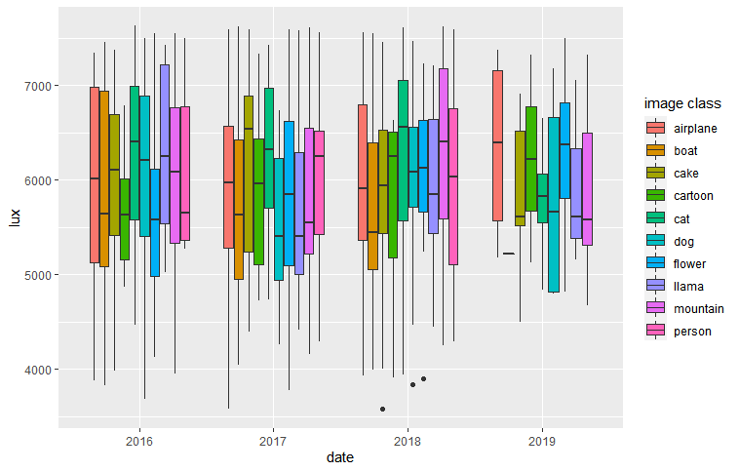
Data with Minimal Outliers Continued
A large reduction of the boat class in 2019 is evident in the graphs below.
Box Plot Of juu Grouped By Image Class And Year
Box Plot Of lux Grouped By Image Class And Year

Slide 8
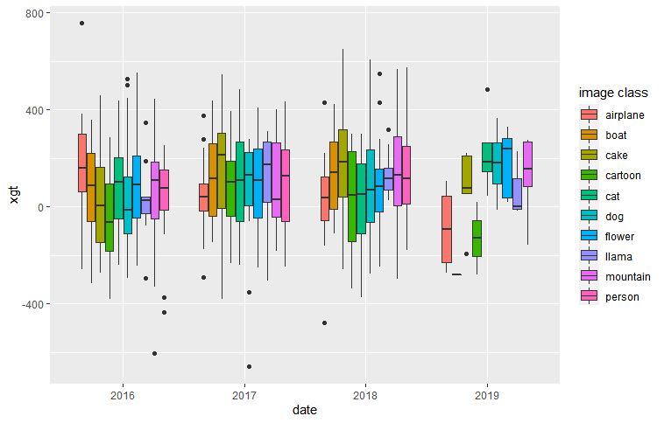
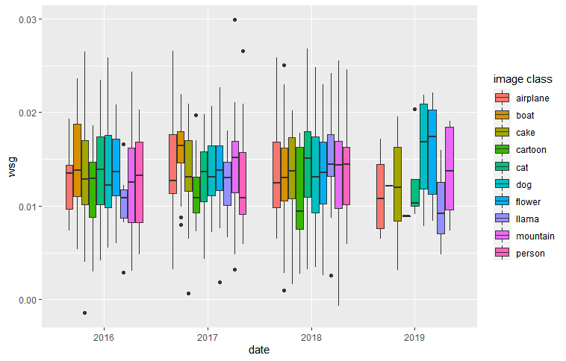
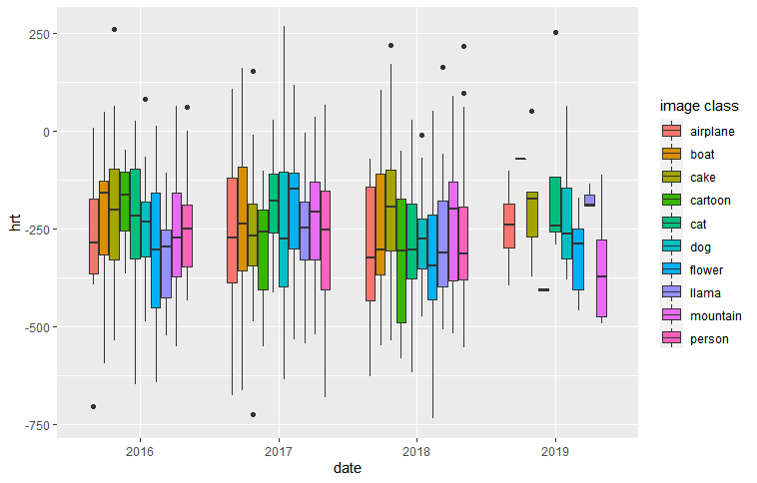
Data with Minimal Outliers Continued
Box Plot Of xgt Grouped by Image Class and Year
Box Plot of wsg Grouped by Image Class and Year
Box Plot of hrt Grouped by Image Class and Year
We see a continuation of a disruption in the classes and their averages in 2019.

Slide 9
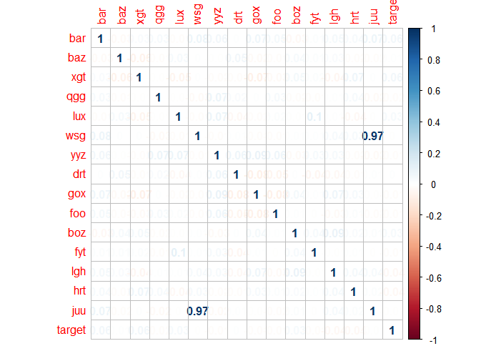
97% correlation between JUU and WSG
Correlation Matrix Of All Variables Except For Image, Image Class, And Date
Correlation does not equal causation but there is strong evidence of a relationship between juu and wsg.
It is important to further investigate this pattern to avoid double counting before constructing a predictive model.
Preliminary tests did not reveal clear correlation among other values.

Slide 10
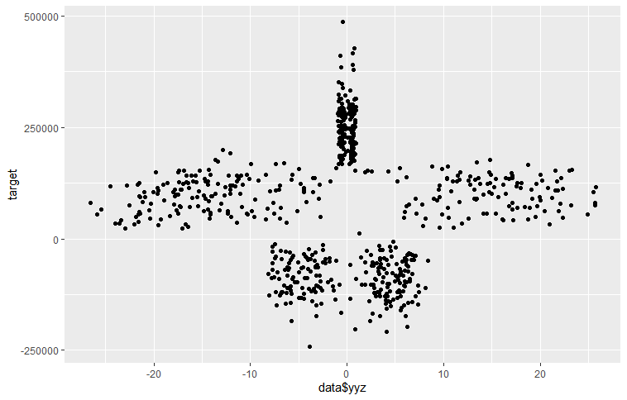
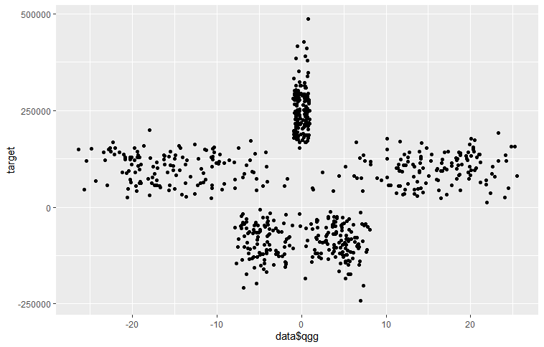
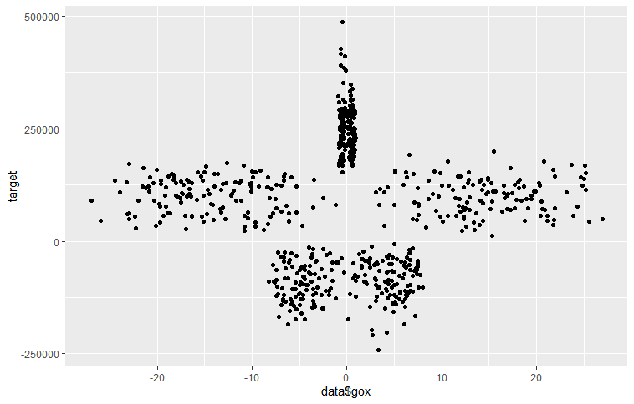
Variables with Similar Relationships to Target
Yyz as a Function of Target
Qgg, yyz, and gox all have a similar relationships as a function of target
Qgg as a Function of Target
Gox as a Function of Target

Slide 11
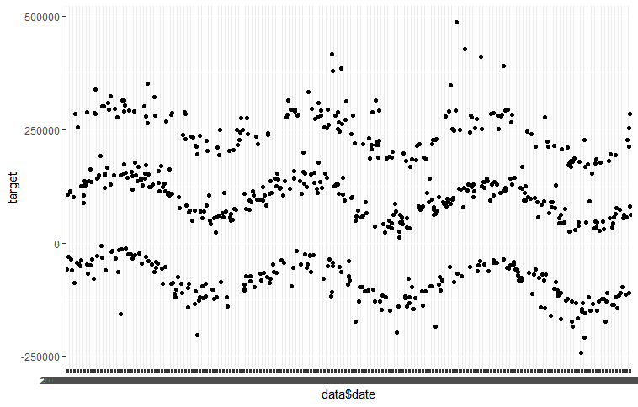
Exploring Target Variable and Date
Target vs. Date
Target appears to follow three sinusoidal functions all with different initial upward shifts at time zero.

